Slide 1


CYP IAPT Midlands Collaborative Recruit to Train programme evaluation
Phase 1 (2018 Cohort)
Dr Dina Gojkovic Grimshaw, Research and Evaluation Lead
Jasmin Stevenson, Research Officer
Colette Procter, RtT Project Manager for Midlands Collaborative
Dr Fiona Warner-Gale, Midlands CYP IAPT Collaborative Project Lead
21st March, 2019

Slide 2
Elements
Completed Phase 1 (January-November, 2018)
  Baseline and Endline survey of 11 RtT trainees.
  Survey of clinical supervisors
  Focus group with commissioners/providers
  Individual interviews with course tutors
To collect in Phase 2 (January-November, 2019)
  Baseline/Endline survey of trainees
  Data tool aimed to capture data on the trainees’ caseload (no response in Phase 1)
  Survey of families and young people (low response in Phase 1, so will continue in Phase 2)

Slide 3
About the Trainee Survey
10/11 respondents ( 6 CBT and 4 SFP) completed the baseline survey.
7/11 respondents (4 CBT and 3 SFP) completed the endline survey.
Questions asked included previous roles within mental health, educational background, and role specific questions, such as whether they feel supported within their role and how their workload is assigned to them
Respondents rated their existing knowledge, skills and confidence in relation to 12 areas pertinent to their role
Ratings were made on a Likert scale of 1 – 5, with 1 being ‘I have no knowledge / skill /confidence’ and 5 being ‘I have considerable knowledge / skill / confidence’.

Slide 4
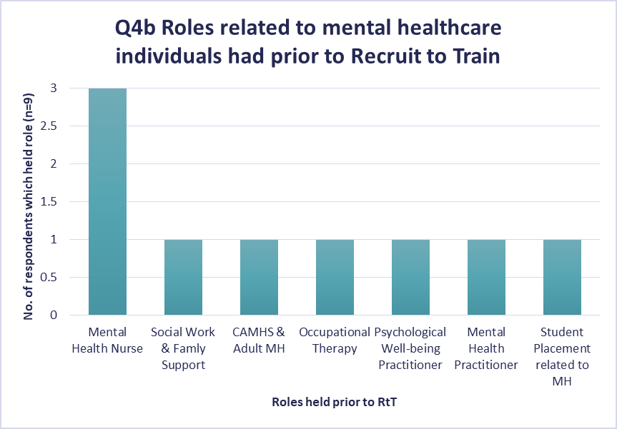
Respondent Demographics
6/10 trainees who completed baseline are educated to a degree level, and the remaining 4 have a professional (vocational) qualification.
9/10 respondents had previously worked in a role related to mental health

Slide 5
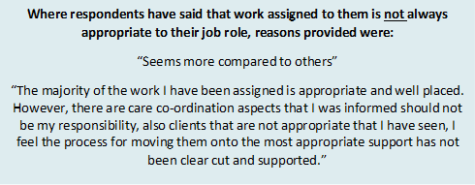
The workload
Trainee workload is assigned by different people, with Clinical Supervisors being the most common (either drawing from the waiting list, or through discussion with the multi-disciplinary team). Clients were referred to them via direct referrals to the service
8/10 respondents felt that their workload was appropriate for their role.

Slide 6
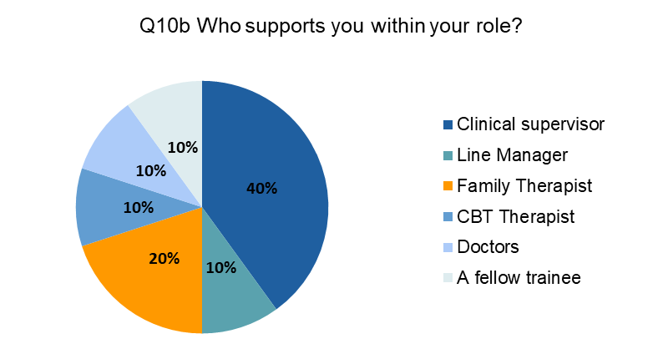
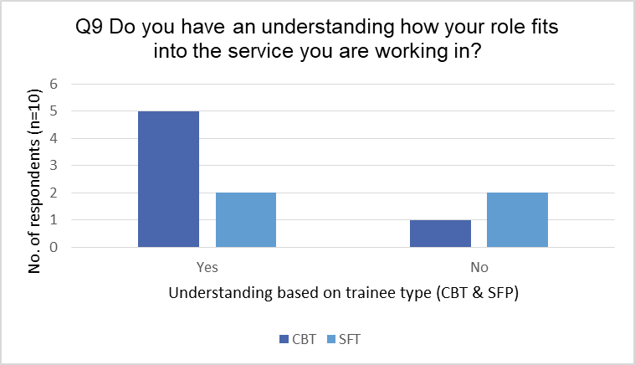
Understanding the role and feeling supported (baseline)
Only baseline data available at this stage. 7/10 respondents had an understanding of how their role fits into the service they are working in (CBT (n=5/6); SFP (n=2/4).
All but one SFP trainee, said that they had someone they could ask for role-specific support within their service.

Slide 7
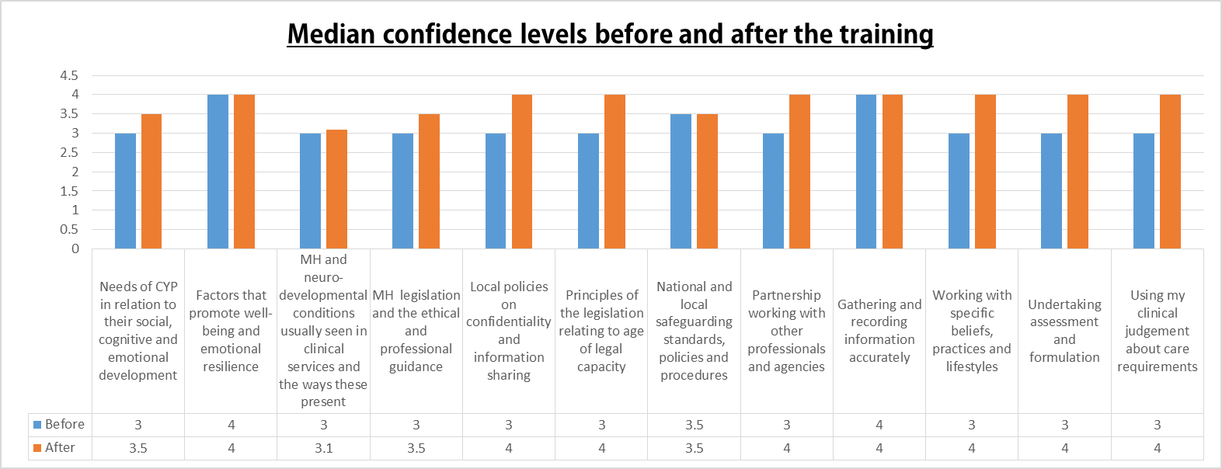
Change in knowledge and skills in 12 areas of training from baseline to endline
c
c
Notes:
Scale 1-5

Slide 8
Statistically significant change in levels post-training* (t=-4.89, p<.05)

Slide 9

Endline survey: Do I have core knowledge, skills and competencies in SFP, following my training?
Endline survey contained 13 statements, all starting with ‘I have core skills for’ or ‘I have knowledge of’ . They were asked whether they agreed or disagreed with them.
For 11 of these statements, 100% agreed that they had knowledge/skills/competencies associated with SFP practice, following the course.
For 2 statements, however, one person said that they neither agreed nor disagreed with them.

Slide 10
Do I have core knowledge, skills and competencies in CBT, following my training?
Endline survey contained 13 statements, similar to SFP, but pertaining to CBT training
For 10 of these statements, 100% agreed that they had knowledge/skills/competencies associated with SFP practice, following the course.

Slide 11
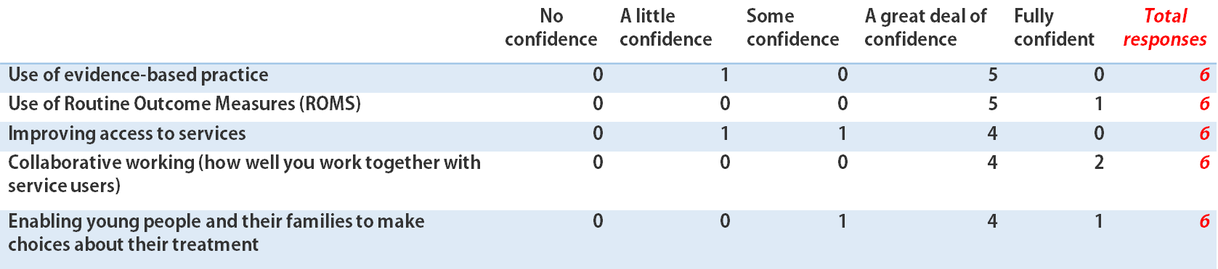
Embedding CYP IAPT principles in practice post-training
6/7 respondents answered this question
Between 4/6 and 6/6 respondents agreed that they felt that they had a great deal of confidence/were fully confident in embedding these principles

Slide 12
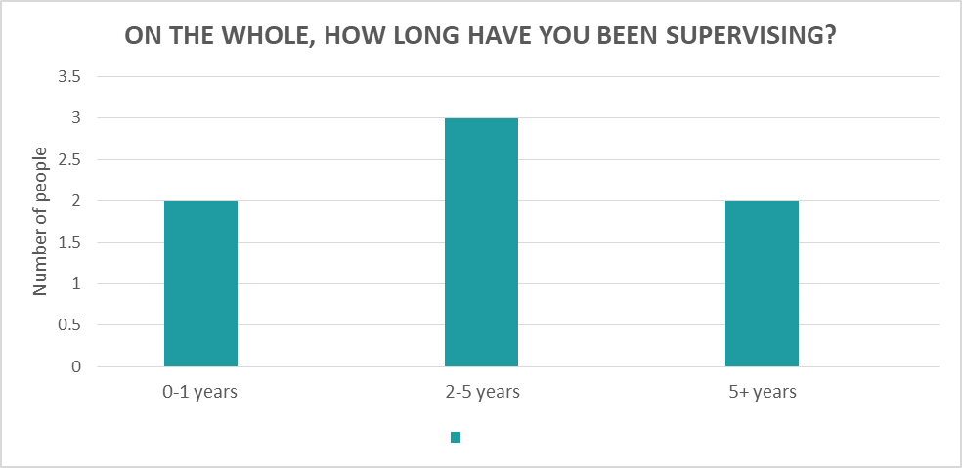
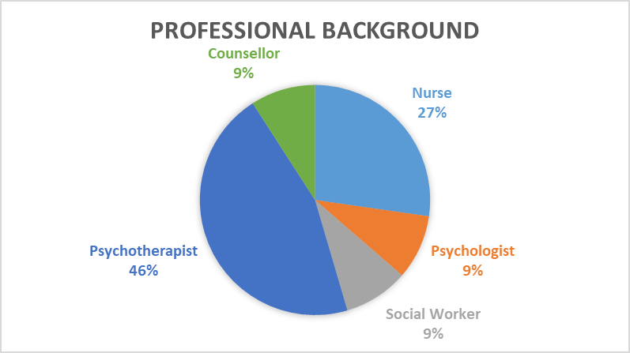
Survey of clinical supervisors
7 respondents with a broad range of professional qualifications. 6/7 accredited by an appropriate body
3 people have a full or pending BABCP (British Association for Behavioural and Cognitive Psychotherapies) accreditation
3 people have AFT (Association for Family Therapy and Systemic Practice) accreditation
All 7 supervisors have CYP IAPT supervisors’ training.
6/7 have been supervising for less than a year, since completing this course, but the majority of people have supervised over two years, on the whole.

Slide 13
Supervision highlights
Most supervision sessions last between 1 and 1.5 hours.
5/7 supervisors work to a supervision model. The most common ones include:
Proctor’s model (Proctor, 2001)
Mason Model (Mason, 2010)
All 7 have supervision contracts and they all supervise weekly.
6/7 supervisors offer 1:1 sessions.
6/7 use ROMS as part of supervision. Mostly to reflect on work done, efficacy of approach and supervisory relationship
Notes:
The one supervisor who offers only group supervisions
30mins per trainee, in a group format. So for two trainees, 1 hour. For 3 trainees, 1hr30mins. These sessions are weekly. In the focus group, group supervisions were praised as a time-saving strategy for the supervisors, especially, where there are a lot of trainees.

Slide 14
Supervisor survey-How do RtTs fit within the service?
Most supervisors agreed that RtT trainees require different supervision than trainees who are not RtT.
“The RtTs, compared to other trainees that I supervise, have a different level of experience. They have spent less time within mental health services and had significantly less experience in working with the population than the other trainees. This leads to different focus for supervision. In addition, the hours required for the CYP IAPT programme are intense meaning that skills need to be acquired at a different pace to other trainees who are experienced.”
Notes:
Typically, RtTs have less understanding of referral pathways, safeguarding processes, caseload management and team meetings, which sets a different pace for supervision.
This has particular relevance in terms of planning the supervision of the current cohort and future cohorts.

Slide 15
As a result, the experience of having RtTs, is also quite different from one service to another. While the supervisors agreed that the trainees worked hard, the overall experience is, on the whole, mixed.
“In my experience, the recruit to train colleague integrated very well and communicated any challenges well.”
“There is a very difficult fit in terms of the Service not being supportive to them. It has been extremely difficult for them to have it clarified who is managerially responsible. They are hosted in a team but seem very much on the outside. There are also no plans in place in terms of their role after the course.”
“…Mixed experience, at times challenging, given limited experience.
The service has not yet decided how to use the skillset, but working well within the team.”
Notes:
Learning from this is important to ensure positive experiences for future RtT trainees and planning for after the course finishes

Slide 16
Has the students’ confidence increased in these areas, since the beginning of the course?
The supervisors were asked to rate the extent to which students’ confidence in the following areas has changed, as a result of the course. 10/11 trainees were rated
Most RtT trainees were rated as knowing quite a lot/a great deal more about these areas, following the training.

Slide 17
Qualitative Data: Focus groups and interviews
1 focus group (face-to-face) and 2 semi-structured interviews (telephone) took place to evaluate how key stakeholders felt the course had been running, what the benefits and challenges had been.
All were analysed using Thematic Analysis (Braun & Clarke, 2006).
The focus group participants (n=4) were 2 CYP IAPT Provider Leads, 1 CCG Lead and 1 senior manager
The telephone interviews were with 2 course tutors.

Slide 18
Overview of key qualitative themes
Factors that determine success of RtT placement
Advantages of the training
Additional workforce
Challenges in implementing the scheme
Short-term intense demand on service, without long-term benefit
Caseloads, referrals, time management, understanding of the service
Readiness of the service
Supervision: success and demands
It’s practical: learn as you go

Slide 19
Factors that determine success: How trainee-ready is your service?
“I think it depends on how IAPT ready, up and running each partnership is. It’s the simple things like what to do with the data collection, what psychometrics to use. For instance, we teach our trainees to use ROMS, but not all services use them. So where do you go from there?”
Interviewees (focus group participants and course tutors) agreed that there are a number of factors that determine the success of the placements.
Surveyed clinical supervisors agreed with this, with one stating that their service should not be taking on any more trainees in the future because they were not properly supported.
Some interviewees noted that there needs to be sufficient infrastructure, availability of trained supervisors, and application of CYP IAPT principles, in order for trainees to fit in.
Hire mentors in service, possibly former trainees, to smooth the transition for new recruits and reduce pressure on supervisors.
“Students may need a mentor at their workplace, someone who can help them get through the intense course. Maybe someone who has also done SFP training. They may feel less isolated that way, especially those who are new to the service.[…] Help them feel more connected to the service.”
Notes:
There is evidence to suggest that the success of placements are influenced by where trainees are placed, the makeup of their teams, clear line management, support from the service,

Slide 20
Factors that determine success:
Supervision as a key factor
“We’re looking at buying in supervision because it’s more cost- effective than asking our band 7 and 8’s to do an hour’s worth of supervision a week, and with Well-Being Practitioners starting at the same time everybody sort of needs supervision at the same time. Everybody is just off supervising all the time, and waiting lists are getting longer”-P2
Lack of supervision infrastructure
Within some services, lack of infrastructure to support supervision.
Supervision = additional demand on services.
Key lessons
Buying in supervision to ensure there is enough.
Individual supervision is preferred model, but group supervisions were on offer for both CBT and SFP trainees - more efficient.
No dedicated supervisors.
Current staff working beyond role to supervise.
Forward planning of supply and demand.
Staff trained in supervision.
When recruiting new staff seeing if qualified to supervise.
Group supervision rather than individual - time and cost effective
Academic supervision also needs to be built into the workload.
“There are people supervising above and beyond their current role, we don’t have dedicated supervisors in place. A lot of the other areas are exploring buying in supervision but that comes at a much greater cost, That’s not a sustainable option moving forward , if this training is an annual thing “-P4
Notes:
ONE OF THE MOST HOTLY DEBATED TOPICS. EVERYONE HAD SOMETHING TO SAY ABOUT THIS. MOST PEOPLE WE SPOKE TO AGREED ON THESE THEMES.
HEAVILY SUPERVISED COURSE BOTH IN SERVICE AND AT UNIVERSITY.
Relating to supervision were different scenarios across the professionals interviewed. Generally all participants acknowledged the additional demand to services to provide the necessary levels of supervision for the RtTs.
Lack of supervision infrastructure.
One service had to pay for additional supervision to ensure they had enough to cover the supervision requirement. They were currently offering individual supervision to the trainees, which was considered inefficient. They were intrigued to learn of the service (in example B) about adopting a group supervision model, which they felt would be a huge benefit to them.
B. However, one service reported no issues with providing supervision. Through forward planning in terms of knowing the expectation of supervision for the trainees, recruiting staff who had supervision experience / training as well as thinking creatively about how to utilise the time and resources spent on supervision resulted in a model that fulfilled the requirements of the RTT course, whilst also maximising efficiency for the staff and the service (e.g. using a group supervision approach, rather than individual supervision).

Slide 21
The Benefit of RtT Trainees:
Additional workforce
The RtT trainees are a additional members to the existing workforce. Despite only being secured for one year, the benefit of having an additional staff member for a year is still considered highly positive.
The Recruit to Train trainees are not written into service’s existing workforce plans and so their ability to work within a service does provide an additional capacity which has not been accounted for.
RtTs contribute to the reduction of waiting lists, which is considered important in a time of austerity and decreased funding for services.
Notes:
WE ASKED FOCUS GROUP PARTICIPANTS AND SUPERVISORS IN THE SURVEY ABOUT THE BENEFITS AND CHALLENGES OF HAVING RtTs.
There was an acknowledgement however, that beyond the trainee period for RTTs, they would apply for jobs within the service that already existed (e.g. a staff member left a job and they would apply), therefore there wasn’t actually an additional member of staff beyond the recruit to train period.

Slide 22
The Challenges: Non-recurrent funding for RtT posts
“The challenge is that we can’t rely on that as a permanent member of staff and we’ve got to try and find the funding for them and if we can, that’s great, but if we can’t then we’ve had the benefit of someone for a year but then we have to let them …go.” – P1
RtTs cannot be relied on as a permanent member of staff would; the uncertainty around funding is a big factor in this and the pressure on the service to find this funding.
Services are having to be clear with trainees that there may not be any prospect of a job at the end of their training, which does not always go down well.
There is pressure on both the trainees and managers to secure posts for them after the RtT period. The uncertainty over recurrent funding of these posts raises questions over how this can be continued long term and how it can be embedded into existing workforce plans.
One academic interviewee noted that as a result of this, many trainees lost interest in the course towards the end.
“We’ve had to really make it very very clear for the trainees this time, that this is only a year contract and don’t hound the managers, lots of emails asking for posts, but if something does come up obviously we’d encourage them to go for it if we thought it was appropriate. This adds stress for the managers because they feel responsible” – P3

Slide 23
The Challenges: Additional pressure for those not from a mental health background
For those outside of a mental health background, it was not easy to meet the specific requirements for the course, despite having experience with children and young people (e.g. voluntary sector).
Course tutors also picked up on this point, with one saying that, while they offered more flexible criteria in the previous cohort, they had a better idea of what professions would do better in the next cohort, so they actively sought out people with that experience.
It would be useful to have some sort of formal recognition of professional qualifications that candidates should possess against which the universities could benchmark.
One of the recommendations was to allow for an extended induction to the service, before the start of the course, to acclimatise the trainees. This would mean that the recruitment process would need to happen earlier to allow sufficient time for this.
‘Now we understand some of those challenges and we made sure that the people who were coming on to Recruit to Train had decent therapeutic experience. I think even the CAMHS services were aware that this was a bigger process than anyone anticipated. It ended up being that the students that weren’t prepared for all the work that they needed to do they struggled to keep up academically and clinically with their peers who were already used to CAHMS.
I did see that difference and it did come across[…] higher anxiety and less self confidence, which impacted on their overall performance.’

Slide 24
The Challenges: Getting the right balance academic vs. clinical
Both academic tutors and commissioners/providers agreed that the needs of the workforce differ from the requirements of the university. Clinical vs. academic. Mismatch of expectations - some expectations were unrealistic.
A CAMHS therapist’s caseload is approx. 35, RtT trainees are only required to have a caseload of 6-8, presenting a disparity between the needs of the service and the needs of the trainee.
“It said something on [the advert] about a handful of cases and that’s not realistic in the modern NHS[…] We’ve tried to get that medium, because we still know that these people have to fulfil a course, and one of the crucial things for us is making sure that they finish on time and that they are supported…There’s still an expectation, whether it’s a meeting or whether it is being able to take a phone call from a parent rather than be absent because it’s a study day. We expect them to be available as you would do if you were an everyday clinician”
Notes:
There was an emphasis around ensuring trainees responded to the needs of the service and didn’t expect that when they weren’t seeing clients they could study, as other daily tasks had to be achieved.
“slips that can happen between what the universities requirements are and what the workforce requirements are so then I guess in the collaborative we end up being the go between [a bit of a mismatch] both and trying to get a balance and you can learn from experience… so for year 3 we’ve learnt to think about actually how are we setting this up from the beginning the expectations, the roles, we’ve increased the banding so that we’re expecting that level of seniority, but I can envisage that we’ll still have some of the challenges that come up anyway, and it’s some of the practical stuff like study days and what do they do when they’re not in university, don’t they still take it off as a study day or should they actually be at work? Because they’re employed to be at work umm or the university stipulation around 6-8clients and it’s like well compared to your colleagues who’ve got case-loads of 35 [yeah] actually seeing only 6 people a week is not really acceptable you know as a service”

Slide 25
The Challenges: Providing the appropriate cases for trainees
Some participants noted a huge challenge of finding the right caseload for the RtTs, and the complexity reaching a balance between the training they are undertaking and the types of cases the service works with.
There was a feeling that the trainees require cases ‘without complexity’ and that isn’t often available within their service – which put further pressure on the staff.
In the future, it would be useful for the services to make themselves aware of the course requirements and assess whether they are able to accommodate these requirements.

Slide 26
Conclusions
On the whole, RtT training made a positive, albeit, short term-impact on the services.
There was a short-term intense demand on services, without a long-term benefit.
The programme allowed trainees from other fields to re-train and boost the MH workforce, which was deemed very positive.
The training made a statistically significant difference in the trainees’ knowledge and confidence and equipped them with skills needed to work as therapists.
The specialist nature of the training meant that they were able to engage with the clients, and they provided a much-needed additional workforce.
Several challenges were identified, and Cohort 3 has already gone some way in rectifying those challenges, e.g. screening professional backgrounds more thoroughly.
Supervision of RtT trainees is different from that of their more experienced colleagues within CAMHS. The supervision requirements of the course placed additional strain on stretched services.

Slide 27
Conclusions cont.
There have been considerable challenges in integrating RtT trainees within services.
Most services were unable to fund the RtT posts after they completed their training, 2 year contracts were not provided to most trainees.
Some RtT trainees struggled to keep up academically and clinically with their peers on the courses who were already used to CAMHS.

Slide 28
Recommendations
Confirm that services are ready to receive RtT trainees and that they can accommodate the unique requirements of the course in terms of supervision and appropriate cases.
Ensure that there is sufficient infrastructure, availability of trained supervisors, and application of CYP IAPT principles, in order for trainees to fit in to services.
Trainees need to have a professional qualification such as nursing, social work or psychology, in order for them to be able to apply for CAMHS jobs after completing the course.
Balance recruitment criteria: ensure that the trainees’ professional background/experience recommends them for the job but, at the same time, brings people from different fields in order to boost the workforce (rather than ‘recycle’ existing mental health staff).
Recommendation for HEE to try and bring the recruitment process forward to allow for an extended induction to the service, before the start of the course. To acclimatise the trainees, especially those who come from outside the mental health field.

Slide 29
Recommendations cont.
Provide new recruits with cross-service mentors, preferably someone who has done the course before (especially important for SFP trainees in services which may not have other SFP therapists on site).
Streamline clinical and academic expectations and establish closer communication between clinical and academic supervisors to manage course expectations and student progress.
Consideration needs to be given to how to ensure ongoing funding for the posts once the trainees are qualified and make the posts sustainable to prevent services investing time and clinical expertise in trainees to lose them when the course ends.

